Slide 1




WILLY NORBERT IRABARUTA 27463
INRODUCTION TO
BIGDATA ANLYTICS
CAN WE PREDICT WHETHER A PATIENT IS DIABETIC BASED ON THEIR MEDICAL RECORDS?
01
FINAL EXAM FOR BIGDATA

Slide 2

IRABARUTA WILLY NORBERT 27463
Introduction
-----
Diabetes is one of the most widespread chronic diseases globally. It is a condition where the body cannot effectively use insulin, leading to high blood sugar levels. If not detected early, it can lead to serious health complications. Early detection is therefore very important for proper treatment and lifestyle management. In this project, we used a dataset of patients containing information such as age, gender, BMI, cholesterol levels, and HbA1c to analyze which factors influence diabetes risk the most. We applied machine learning models to predict whether a patient is diabetic or not and presented all findings using a Power BI dashboard to make the results interactive and easy to understand.
02
FINAL EXAM FOR BIGDATA

Slide 3

IRABARUTA WILLY NORBERT 27463
Problem
Statement
The main challenge in diabetes diagnosis is that it is often identified too late, when complications have already developed. Many people with diabetes remain undiagnosed due to lack of early screening. Our project attempts to solve this issue by creating a data-driven approach to predict diabetes risk. We aimed to clean and analyze patient data, identify significant risk factors, train machine learning models for prediction, and present these insights through a visual dashboard. This helps doctors and healthcare centers to better understand patterns and make decisions based on data.
03
FINAL EXAM FOR BIGDATA

Slide 4


IRABARUTA WILLY NORBERT 27463
Dataset
Overview
The AGE column represents the age of each patient in years. Age is one of the most important risk factors for diabetes, as older individuals are more likely to develop the disease due to metabolic changes
The Gender column identifies whether the patient is male or female. Gender is important because biological differences, hormones, and lifestyle factors can influence the risk of diabetes differently for males and females
The BMI column stands for Body Mass Index, which is calculated as weight in kilograms divided by height in meters squared (kg/m²). BMI is a widely used indicator to classify whether a person is underweight, normal weight, overweight, or obese.
The HbA1c column measures the average blood sugar level over the past 3 months. It is one of the most reliable indicators of long‑term blood glucose control and is used in diagnosing diabetes.
(Chol, TG, LDL, HDL)These columns represent the lipid profile values of each patient. Chol refers to total cholesterol, TG stands for triglycerides, LDL is low‑density lipoprotein (bad cholesterol), and HDL is high‑density lipoprotein (good cholesterol). Abnormal lipid levels are associated with metabolic syndrome and increase the risk of diabetes and heart diseases.
04
The CLASS column is the target variable that indicates whether a patient has diabetes (1) or does not have diabetes (0). It is the most important column for our project because the machine learning models use it to learn patterns in the data and predict diabetes in new patients.
FINAL EXAM FOR BIGDATA

Slide 5

IRABARUTA WILLY NORBERT 27463
Methodology
Data Analysis
Data Cleaning & Preprocessing
Exploratory Data Analysis (EDA)
Feature Scaling
Machine Learning Models
Model Evaluation
Handled missing values (fillna)
Encoded categorical columns (LabelEncoder)
Removed duplicates
Descriptive statistics (df.describe())
Visualizations (Heatmaps, Countplots, Scatterplots)
Used StandardScaler to normalize data
Logistic Regression
Random Forest Classifier
Accuracy, Confusion Matrix, Classification Report
Clustering
Feature Importance
Power BI Dashboard
Applied KMeans to group patients (High/Low risk clusters)
Found which health factors affect diabetes most.
KPIs, Bar Charts, Pie Charts, Slicers, Filters, AI Visuals.
05
FINAL EXAM FOR BIGDATA

Slide 6
IRABARUTA WILLY NORBERT 27463
Our analysis revealed several important findings about the factors influencing diabetes in patients. The results showed that patients with higher HbA1c levels and higher BMI were at a much greater risk of having diabetes. HbA1c is a strong indicator of blood sugar control over the past three months, and we observed that most patients with HbA1c levels of 6.5% or higher belonged to the diabetic group. Similarly, patients who were overweight or obese, as indicated by higher BMI values, had a greater chance of being diabetic. The feature importance analysis from the Random Forest model confirmed that HbA1c was the strongest predictor of diabetes, followed by BMI and age.
Key Findings
Results
Patients with higher HbA1c and BMI had a higher risk of diabetes
HbA1c indicates average blood sugar over 3 months. We found that patients with HbA1c ≥ 6.5% mostly belonged to the diabetic class.
BMI showed that overweight or obese patients had a much higher proportion of diabetes.
This confirms that blood sugar control and weight management are critical factors in diabetes prevention.
Feature Importance showed that HbA1c was the strongest predictor
The Random Forest model provided a feature importance ranking.
HbA1c had the highest importance, meaning it contributed most to predicting diabetes.
BMI and Age were the next most important, showing that both metabolic health and aging increase risk.
06
FINAL EXAM FOR BIGDATA

Slide 7

IRABARUTA WILLY NORBERT 27463
Power BI
Dashboard
Created a dashboard with KPIs, bar charts, pie charts, and slicers.
Key visuals included:
KPI Card: Showing total high-risk patients.
Pie Chart: Gender distribution of diabetic vs non-diabetic patients.
Line Chart: Trend of BMI vs Age.
Funnel Chart: Stages of patients based on BMI ranges.
AI Visual (Key Influencers): Showed which factors most affect diabetes risk.
07
FINAL EXAM FOR BIGDATA

Slide 8
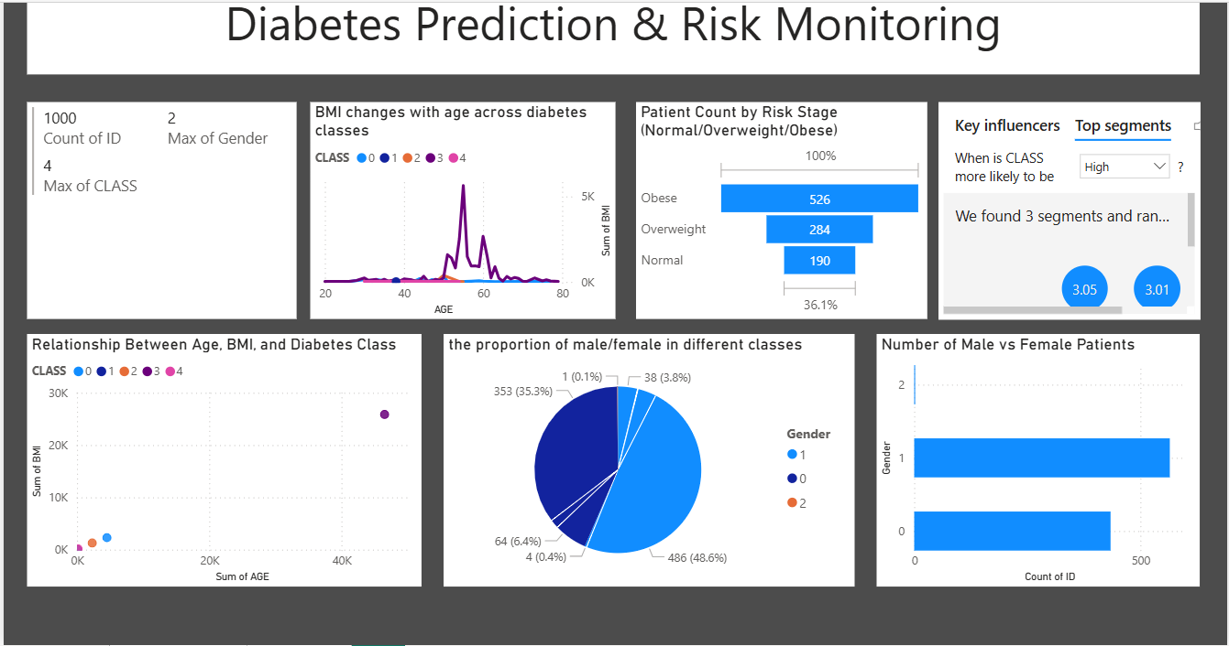
IRABARUTA WILLY NORBERT 27463
08
FINAL EXAM FOR BIGDATA

Slide 9

IRABARUTA WILLY NORBERT 27463
RECOMandations
------
Patients with high BMI and HbA1c should undergo regular checkups.
Lifestyle modifications like diet and exercise can reduce risk.
Awareness programs should focus more on older individuals and obese patients.
Healthcare providers can use prediction models for early detection.
09
FINAL EXAM FOR BIGDATA

Slide 10

IRABARUTA WILLY NORBERT 27463
Future Work
--------
Use larger datasets with more features like physical activity and family history.
Deploy the model as a web app for real-time prediction.
Integrate with wearable devices for live health monitoring.
Improve prediction accuracy using deep learning models.
Add more advanced Power BI features like bookmarks, drill-through pages, and R visuals.
10
FINAL EXAM FOR BIGDATA

Slide 11
IRABARUTA WILLY NORBERT 27463
Conclusion
-----------------------
The project successfully analyzed patient data, predicted diabetes, and presented insights visually.
Machine learning models like Random Forest helped identify important risk factors.
Power BI dashboard allowed interactive exploration of data for better understanding.
This project shows how data-driven decisions can improve healthcare outcomes.
11
FINAL EXAM FOR BIGDATA

Slide 12
IRABARUTA WILLY NORBERT 27463
thank
you!
DATA ANALYSIS IS KEY TO BUSINESS GROWTH AND SUCCESS!
12
FINAEXAM FOR BIGDATA

